Slide 1
Case study analysis
How the course works – content, CUEGIS concepts and cases!
Notes:
These three elements are the pedagogical framework for the course. Pedagogy means the way something is taught.

Slide 2
What are case studies?
A case study is a story about a real business that is making decisions about the future
Case studies typically have a narrative and present information for you to consider
You are expected to answer questions using content knowledge (“book learning”) and also to use the big picture CUEGIS concepts to organize your thinking

Slide 3
What are case studies?
a story, about a real business making decisions about the future
E.g. Heinz Corporation Millennium Project
Case studies present information for you to think about
You are expected to answer questions
using content knowledge (“book learning”) and also
the big picture CUEGIS concepts to organize your thinking

Slide 4
CUEGIS
CUEGIS is simply an acronym for the big picture concepts…
Change
cUlture
Ethics
Globalization
Innovation, and
Strategy
These 6 concepts are the “big ideas” or organizing principles for the study of Business Management

Slide 5
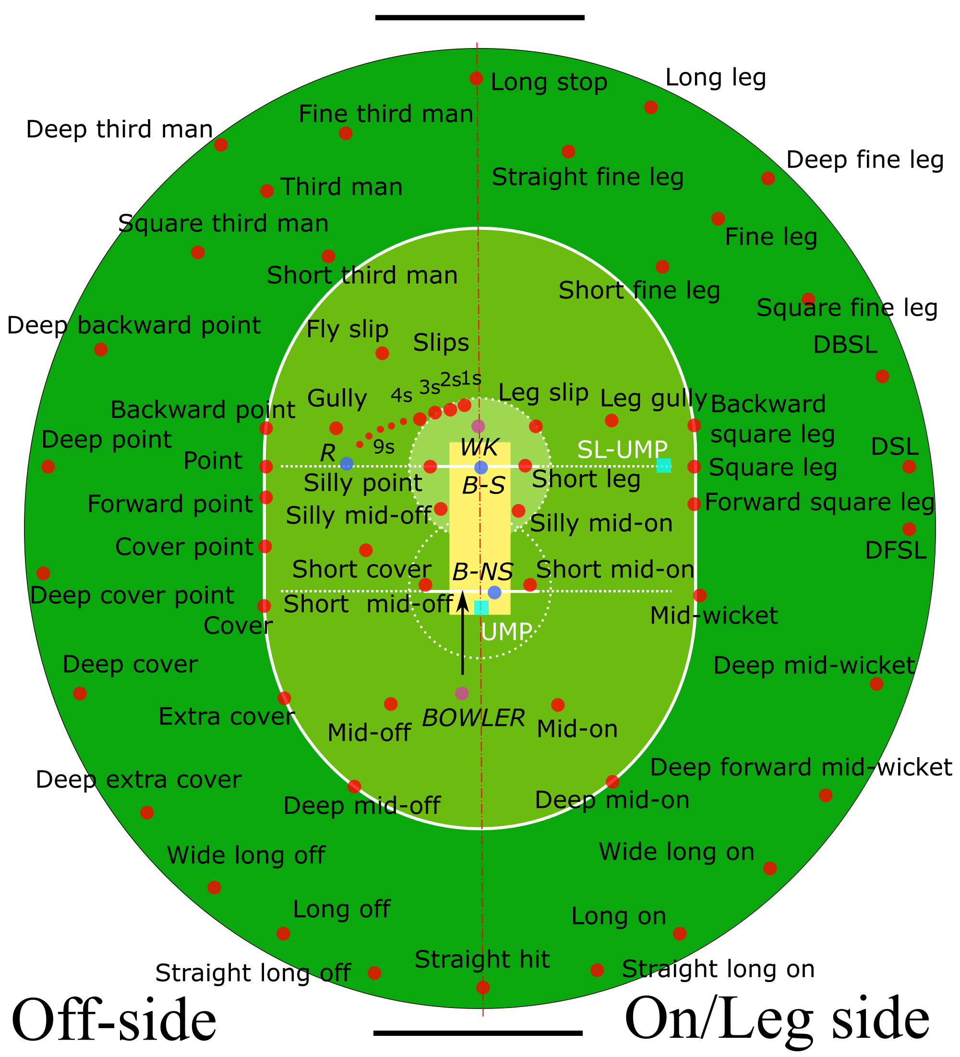
Studying Sports
If you were to study the game of Cricket like you would Business Management, the organizing principles (big ideas) might be
Game play (Rules of the game)
Throwing
Hitting
Running
Fielding
Training and practice
Strategy
We might watch ESPN, study past games and teams to improve our performance and enjoyment of the sport
Notes:
Sports is an activity played by people, much like business. People want to improve their performance and so they study the game to improve.

Slide 6
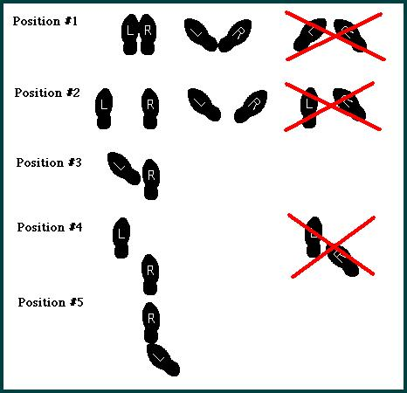
Dance
If we were to study Dance like we study Business Management, we might use organizing principles like…
Rhythm
Body movement
Sound
Costume
Choreography
Creativity
We might watch musicals, ballet and MTV to understand all about Dancing.

Slide 7
Marriage
Task: You know what it is. Create a CUEGIS-like framework of big ideas you might use to become expert at the subject of marriage. Explain how your framework would help you study the activity.

Slide 8
In other words…
You have two ways to organize the whole IB BM course
Using CUEGIS concepts, and
Using the content details (BM Guide)
At the end of the course you will know and see dozens of ways that businesses are affected by change, and you will be able to talk knowledgeably about the many ways and give real examples
Similarly, you will be knowledgeable of the role of Culture, Ethics, Globalization, Innovation and Strategy and can ask and answer questions on how a concept relates to a given situation

Slide 9
Change
Competition, new technologies and markets, and trends in consumer behaviour lead business organizations to adapt their objectives, strategies and operations.
Success emerges from the ability to research and respond to signals in both the internal and external environment.
Task: Re-write this into a sentence you can remember
Notes:
Change is about adaptation of objectives, strategies and operations to changes in the internal and external environment. An example of change is the need to create new products to continuously delight customers.

Slide 10
Culture
Every organization operates in a range of environments in which its role may be interpreted differently. These expectations affect planning, decision-making and strategy implementation.
Within an organization, values and backgrounds influence what stakeholders focus on and how they work.
This will make you laugh
http://www.youtube.com/watch?v=fUXdrl9ch_Q
Notes:
Businesses operate in social contexts that vary in the ways they impact the business. AIS must obey the Ministry of Education and the laws of the land. As an Australian school our decisions impact our students. We are a mixed classroom of Emirate and non-emirate students learning an international curriculum.
In our classroom culture it is ok to make mistakes. When someone makes a mistake we say “That’s OK”. When someone does not know the answer they say “Help me” and someone else tries. This is our organizational culture. Our culture makes it easier to learn and we learn more.

Slide 11
Ethics
Every business decision has moral implications.
These consequences can be significant for internal and external stakeholders and the natural environment.
The power of rationalization
http://www.youtube.com/watch?v=XBmJay_qdNc
Notes:
In our class, learning is most important. That is because learning is important to success and survival. It is good to help others learn. It is immoral to interfere with the learning of others.

Slide 12
Globalization
A wide range of international forces (such as the increasing social, cultural, technological and economic integration) influence business organizations. In turn, business organizations shape these forces.
Many business organizations operate across national boundaries. Even local businesses and consumers are influenced by global forces.
Malcom McLean
http://www.youtube.com/watch?v=Gn7IoT_WSRA
Notes:
Our school is an example of the forces of globalization in education. We are delivering the Australian and IB curricula within the UAE. Is that cool or what?!

Slide 13
Innovation
Incremental or radical improvements to a business idea, or the generation of new ideas in relation to a final product, service or process, are the result of internal or external influences.
For many business organizations, a key challenge is bringing in ”the new” and managing the process of improvement in a sustainable way.
Cool Anki toy – I want one for my birthday
https://anki.com/en
Notes:
For us at AIS, the IB is an innovation. Teachers and parents see it as something new. But the IB has been around for many decades. The IB undergoes a process of continual improvement. Every 7 years the course syllabus changes. So the course content is always being improved.

Slide 14
Strategy
Strategy refers to the significant long-term planning decisions that organizations make in order to meet the needs and wants of their stakeholders.
Strategy is about asking questions: what, why, when, how, where and who?
A “three legged stool” (first 5 minutes only)
http://www.youtube.com/watch?v=rJ2tmqRkiCM
Notes:
Strategy is thinking ahead for the future. Strategy is not short term – what is on the test is not strategy? Do I do math homework or business homework is not strategy. Strategy is long term – what university are you attending? Who are you going to ask for a recommendation for university? What is next after high school?
Strategy requires organizations to ask 5W and H questions about their business activities.

Slide 15
Questions
1. Explain the concept of Change with the case study Utopia.
2. How could cUlture affect Utopia’s business decisions ?
3. Are there any ethical decisions regarding Utopia?
4. How has Globalization impacted Utopia?
5. Identify at least two innovations regarding Utopia?
6. Explain Utopia's current business strategy. How will it look if John chooses either Liza and Paul’s new growth strategy?
7. How will the organizational structure and chart change with either Liza or Paul’s new growth strategy?

